Slide 1
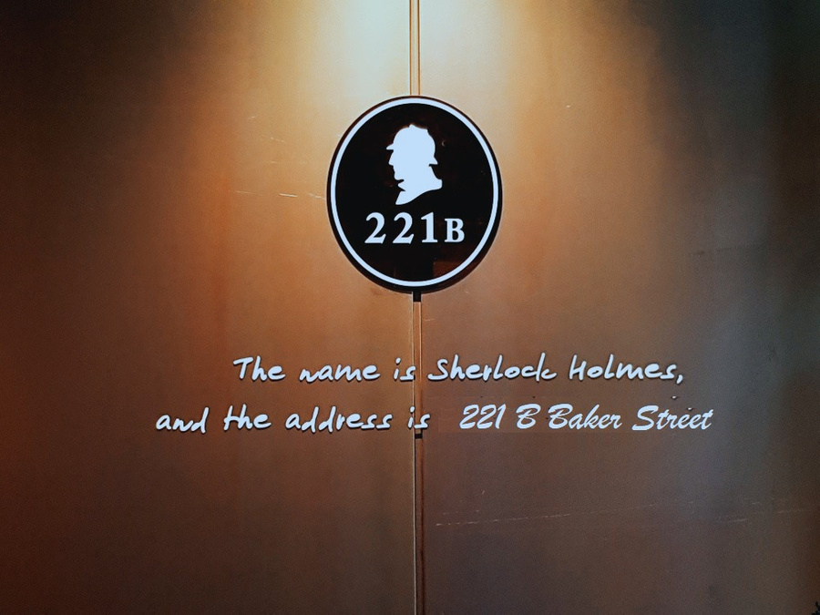

Concurrency in JAVA
Concurrency In JAVA
01
MAKE
MIND MATRIX
... A LEARNING
BUILDING BRAINSTORM @ 221B BAKER STREET
C F E

Slide 2


CLIENTS
CLIENT 1
To create a stunning presentation, it's best to simplify your thoughts. Start with an outline of topics and identify highlights, which can be applied to whatever subject you plan on discussing. You can then organize them into your introduction, your main content, and your conclusion. To create a stunning presentation, it's best to simplify your thoughts. To create a stunning presentation, it's best to simplify your thoughts.
—We developed relationships with new customers every month in various key demographics
CLIENT 2
To create a stunning presentation, it's best to simplify your thoughts. Start with an outline of topics and identify highlights, which can be applied to whatever subject you plan on discussing. You can then organize them into your introduction, your main content, and your conclusion. To create a stunning presentation, it's best to simplify your thoughts.To create a stunning presentation, it's best to simplify your thoughts.
05

Slide 3
AWARDS AND RECOGNITION
AWARD 1
AWARD 2
AWARD 3
Presentations are communication tools that can be used as demonstrations, lectures, speeches, and more.
Presentations are communication tools that can be used as demonstrations, lectures, speeches, and more.
Presentations are communication tools that can be used as demonstrations, lectures, speeches, and more.
ARCHITECTURE PRESENTATION
04

Slide 4
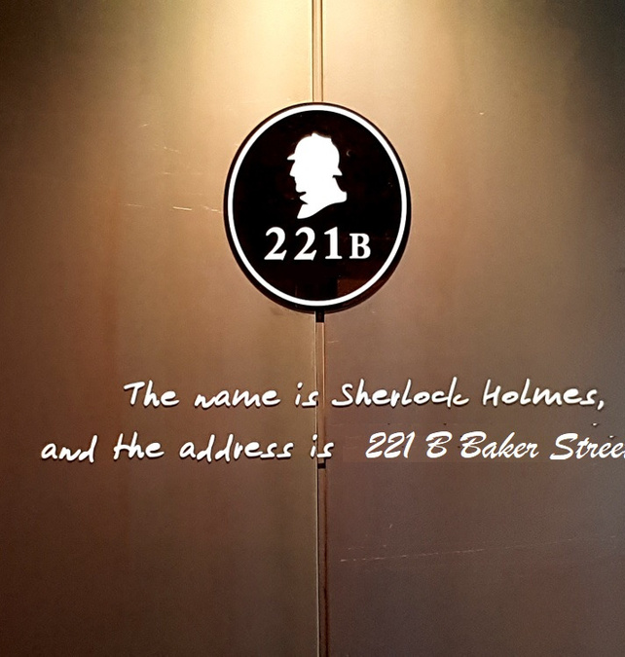

Concurrency in JAVA
Concurrency In JAVA
01
MAKE
MIND MATRIX
... A LEARNING
C F E
BUILDING DREAMS SINCE 1995

Slide 5




Visual Arts
Eastside Learning Academy
TEACHER:
PAUL SMITH
VISUAL ART
2020
EASTSIDE LEARNING ACADEMY

Slide 6


Slide 7


Sierralane Architects
Presentations are communication tools that can be used as demonstrations, lectures, speeches, reports, and more. It is mostly presented before an audience.
01
BUILDING DREAMS SINCE 1995

Slide 8


Featured projects
Presentations are tools that can be used as lectures, speeches, reports, and more. It is mostly presented before an audience.
13

